Slide 1


Prototype Submission Phase

Slide 2
TEAM NAME and MEMBER DETAILS
Team 405: Found Yukta Bhardwaj Rashmika Das Hanush Singh Rajputh Saatvik Shashank Shrivastava
Shaik Aftab Ahamad Shariff
THEME:
API Call Analysis and Alert System, using AI

Slide 3
PROBLEM STATEMENT
In large scale distributed platforms, APIs operate across on premises, cloud, and multi-cloud environments, generating vast amounts of heterogeneous log data from high-frequency API calls. The problem is that traditional monitoring systems are unable to efficiently process and correlate this enormous and varied data in real time. As a result, performance issues such as sudden spikes in API response times or unexpected error rates often go undetected until they impact end users. Additionally, because a single user request can traverse multiple APIs across different hosting environments, pinpointing the root cause of anomalies becomes exceedingly challenging. This leads to prolonged downtime, increased operational costs, and diminished user experience.
Our project aims to solve this problem by developing an AI-powered API monitoring and anomaly detection system. The solution will automatically collect and standardize log data using tools like OpenTelemetry and the ELK stack, and apply machine learning models (via TensorFlow and Scikit-learn) to detect anomalies and predict potential failures. By correlating events across various environments, the system will provide real-time, actionable insights that enable proactive intervention, reducing downtime and improving overall platform reliability.

Slide 4
SOLUTION
Our solution employs AI-driven anomaly detection using deep learning architectures like LSTM and GRU to monitor API performance in large-scale distributed systems. By analyzing time-series log data, these models detect response time spikes, error rate anomalies, and predict failures before they impact system reliability.
How It Solves the Problem
The system automatically processes API logs from multiple environments (on-premises, cloud, multi-cloud), detecting deviations and predicting potential failures. It generates real-time alerts for response time spikes and error rate anomalies, reducing downtime and enhancing platform stability.

Slide 5
SOLUTION
Impact Metrics
Reduction in Mean Time to Detect (MTTD) anomalies
Improvement in Mean Time to Resolution (MTTR)
Accuracy of anomaly detection models
Number of false positive/negative alerts
Reduction in API failure rates
Technology Stack
Backend: FastAPI + Uvicorn
Database: PostgreSQL/MongoDB
AI/ML: TensorFlow, Scikit-learn, LSTM & GRU for anomaly detection
Logging & Monitoring: OpenTelemetry + ELK (Elasticsearch, Logstash, Kibana)
Cloud & Infra: AWS for cloud deployment
Dashboard: Kibana/Grafana

Slide 6
SOLUTION
Assumptions & Constraints
API logs contain structured, timestamped data
The model requires historical logs for training
Resource constraints in real-time anomaly detection
Implementation & Scalability
Our solution is easily deployable with existing logging systems and scalable across distributed environments. It supports real-time analytics and adapts to new API logs dynamically, ensuring high usability across enterprises.

Slide 7
METHODOLOGY
Methodology
Our solution follows a data-driven AI approach to monitor and predict API failures across large-scale distributed platforms.
Concept
The system collects, processes, and analyzes API logs to detect anomalies in response times and error rates using deep learning models (LSTM & GRU). It leverages predictive analytics to forecast failures, ensuring proactive issue resolution.
Principles
Real-time Monitoring – Continuously tracking API performance metrics.
Anomaly Detection – Identifying deviations in response time and error rates.
Predictive Analytics – Using past data to foresee potential failures.
Automation – Seamless integration of new APIs into the monitoring system.
Scalability – Supporting multi-cloud and on-premises infrastructures.

Slide 8
METHODOLOGY
Elements
Data Collection: API logs retrieved from different environments.
Preprocessing: Standardizing and structuring logs for analysis.
Anomaly Detection: Using AI models to identify irregularities.
Alerting Mechanism: Notifying stakeholders in case of anomalies.
Visualization: Dashboards in Kibana/Grafana for insights.
Components
Backend: FastAPI + Uvicorn to handle requests.
Database: PostgreSQL/MongoDB for log storage.
AI Engine: TensorFlow & Scikit-learn with LSTM & GRU models.
Logging & Monitoring: OpenTelemetry + ELK Stack (Elasticsearch, Logstash, Kibana).
Cloud Infrastructure: AWS for deployment.
User Interface: Kibana/Grafana dashboards for visualization.

Slide 9
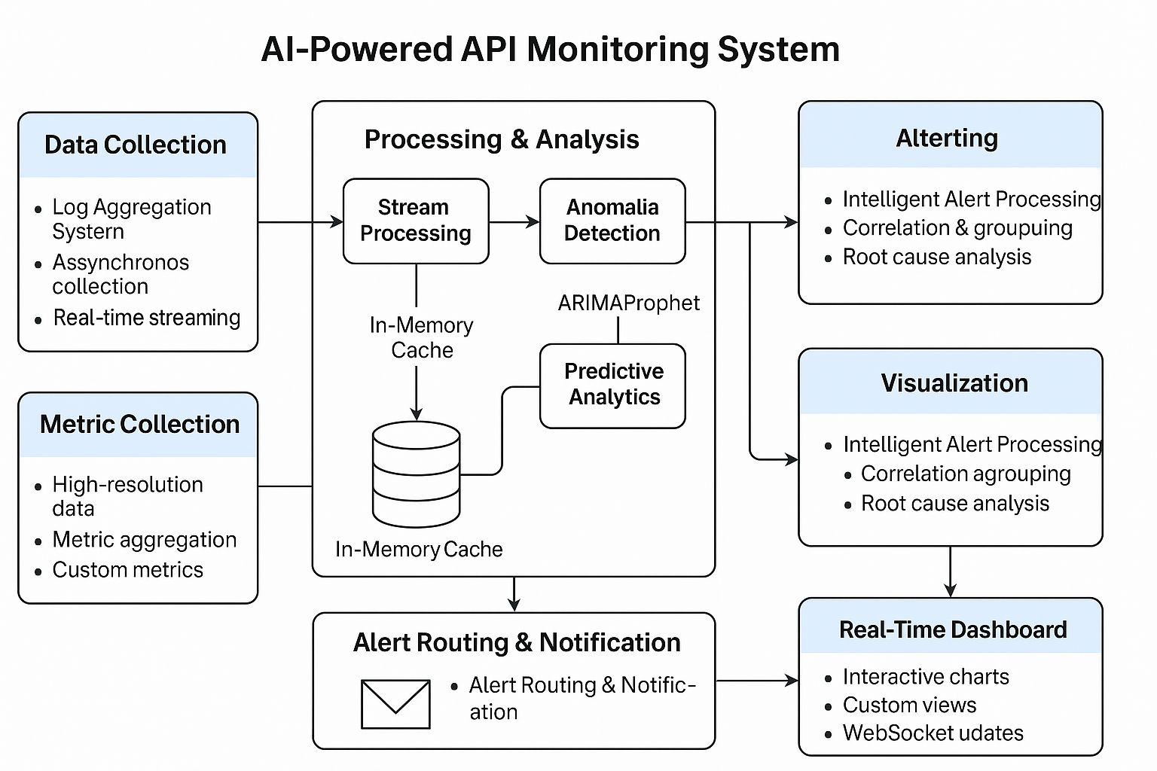
METHODOLOGY

Slide 10
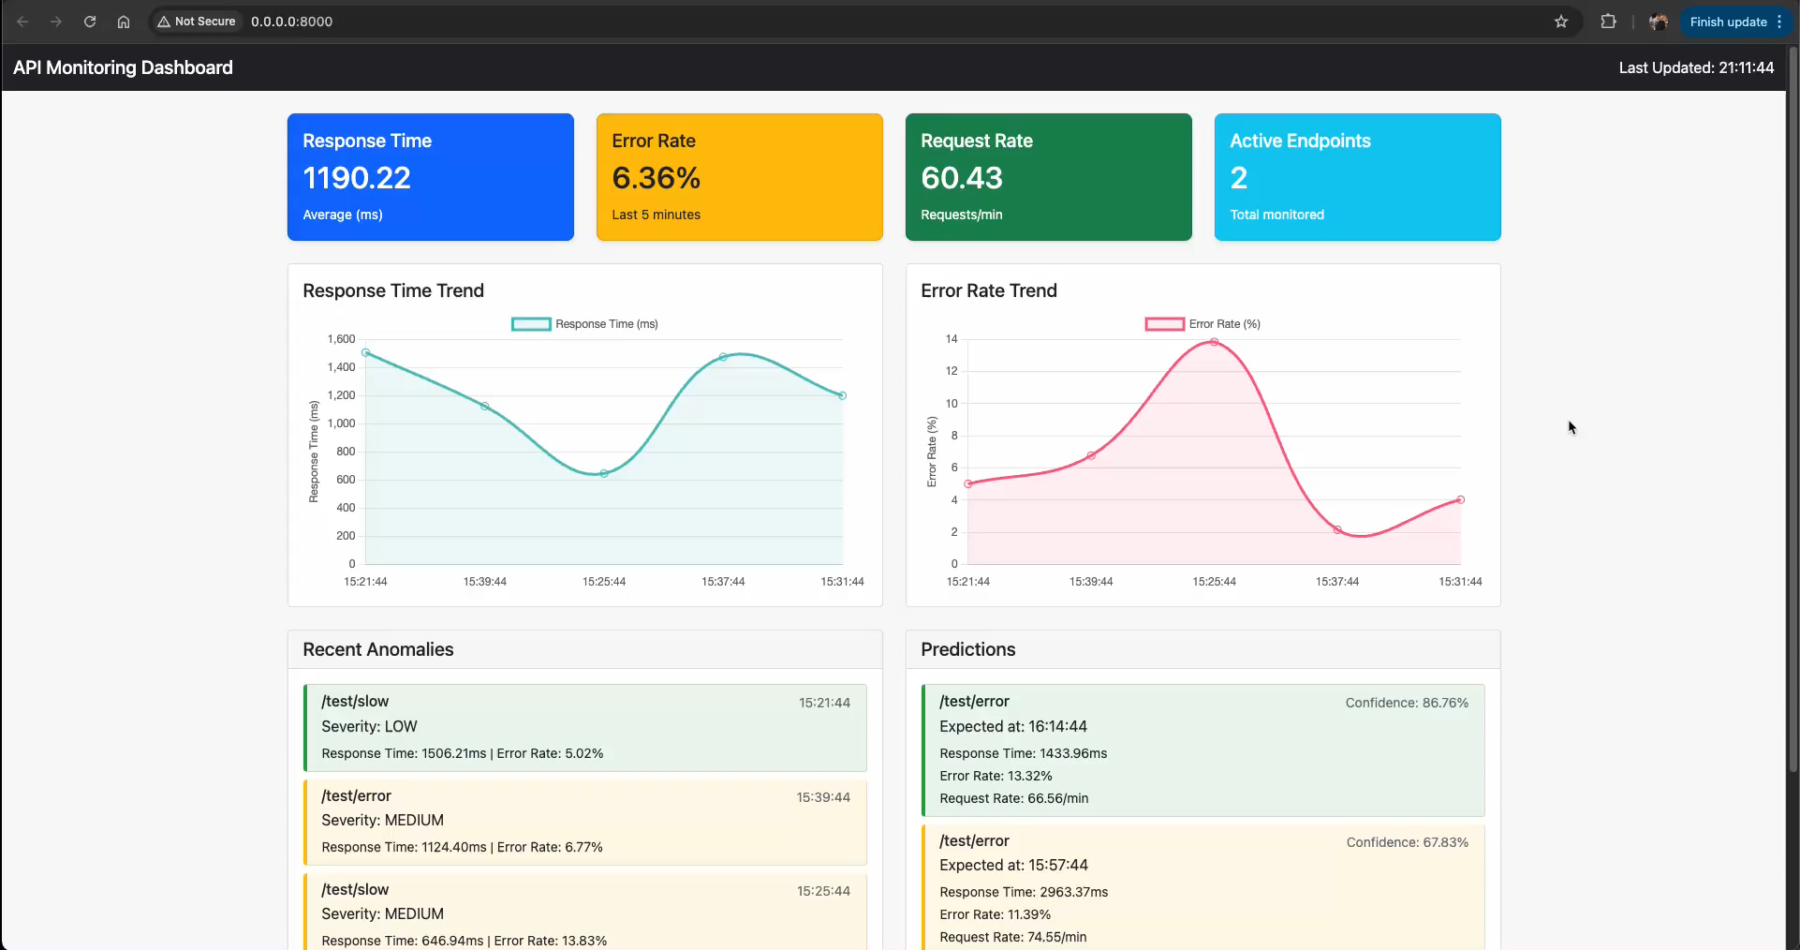
WORKING PROTOTYPE

Slide 11
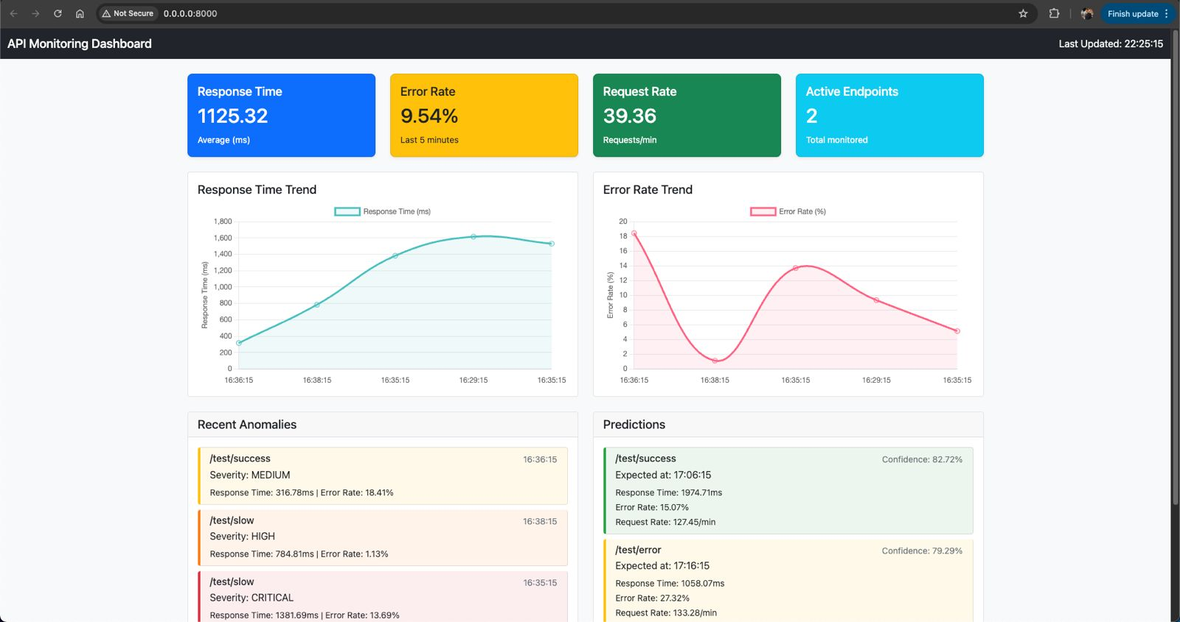
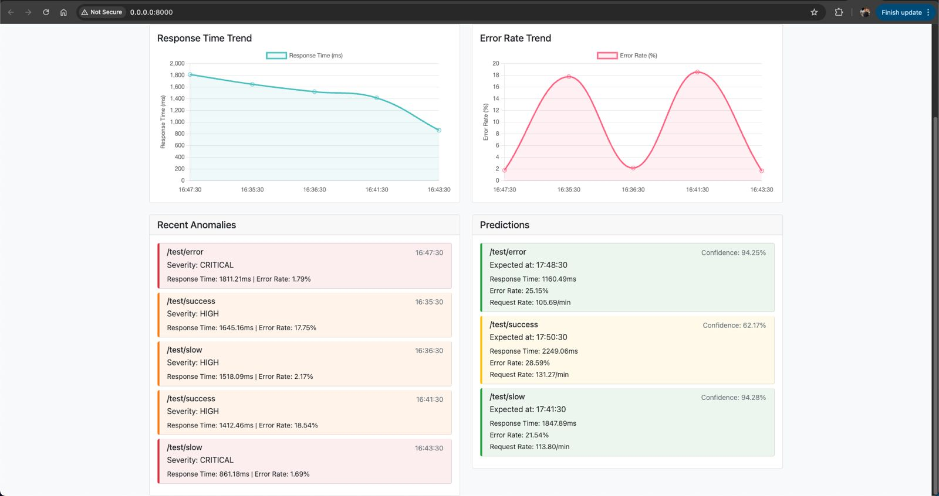
Attachments
GitHub repository- https://github.com/SaatvikSS/Barclays-Hackathon

Slide 12
Thank you!

